Slide 1
Rendering XML documents with XSL
The most powerful approaches to rendering XML documents involve using XSL (eXtensible Stylesheet Language)
XSL enables arbitrary ways of rendering XML documents
  XSL enables an XML document to be translated into any arbitrary format, including, say, PDF or HTML
Server-side software, driven by XSL stylesheets, can transform XML documents into HTML documents before serving them to browsers
In addition, modern browsers, such as Firefox 1.0.2 or MSIE 5.5 or later, can accept XSL stylesheets
We will consider browser-processed XSL stylesheets first and, later, consider server-side use of XSL

Slide 2
Browser-processed XSL
Consider the XML specification below:
  <?xml version="1.0" ?>
  <!DOCTYPE people SYSTEM "personnel2.dtd">
  <?xml-stylesheet type="text/xsl" href="personnel2.xsl"?>
  <people>
  <person>
  <female>Celia Larkin</female>
  </person>
  <person>
  <male>Bertie Ahern</male>
  </person>
  </people>
This refers to a XSL style-sheet, whose content we will examine later

Slide 3
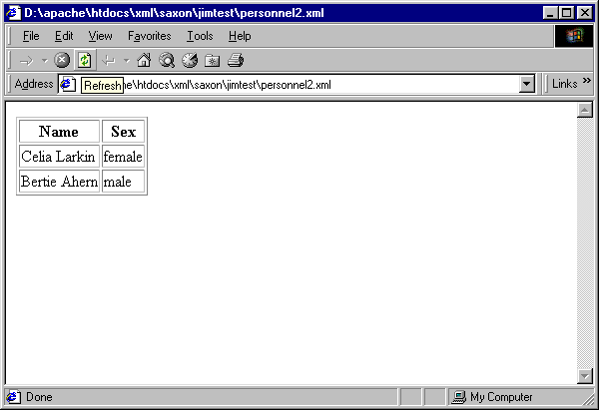
Browser-processed XSL (contd.)
When the XML document on the previous slide is loaded into an XSL-enabled browser it is rendered as shown below

Slide 4
Browser-processed XSL (contd.)
The rendering on the previous slide is produced because the XML document is transformed, by the XSL style-sheet, into the following HTML document:
<HTML>
<BODY>
<TABLE>
<THEAD>
<TR><TH>Name</TH><TH>Sex</TH></TR>
</THEAD>
<TBODY>
<TR>
<TD>Celia Larkin</TD><TD>female</TR>
<TD>Bertie Ahern</TD><TD>male</TR>
</TBODY>
</TABLE>
</BODY>
</HTML>

Slide 5
Browser-processed XSL (contd.)
The XSL style-sheet which transformed the XML document into a HTML document is specified on the following slide
We will then proceed to examine sufficient aspects of the XSL language to understand it

Slide 6
XSL style-sheet
<?xml version="1.0"?>
<xsl:transform xmlns:xsl="http://www.w3.org/1999/XSL/Transform” version="1.0">
<xsl:template match="/">
<HTML><BODY><TABLE rules="all">
<THEAD><TR><TH>Name</TH><TH>Sex</TH></TR></THEAD>
<TBODY>
<xsl:apply-templates/>
</TBODY></TABLE></BODY></HTML>
</xsl:template>
<xsl:template match="person">
<TR> <xsl:apply-templates/> </TR>
</xsl:template>
<xsl:template match="male">
<TD> <xsl:value-of select="."/> </TD><TD>male</TD>
</xsl:template>
<xsl:template match="female">
<TD> <xsl:value-of select="."/> </TD><TD>female</TD>
</xsl:template>
</xsl:transform>

Slide 7
A short overview of the
Extensible Stylesheet Language (XSL)

Slide 8
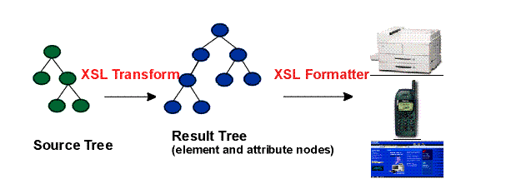
There are two main stages to rendering an XML document using XSL:
  Tranforming the source document into a new notation which has a rendering semantics
  Formatting the resultant document according to the semantics of the notation
XSL provides two (sub-) languages for these two tasks

Slide 9
XSL provides a (sub-)language called
    XSL Transformations (XSLT)
  for tranforming a source XML document into a new notation which has a rendering semantics
XSL provides a (sub-)language with rendering semantics called
    XSL Formatting Objects (XSL FO)

Slide 10
Re-using older notations
We do not have to rely on XSL FO
We can use XSL to transform XML into any other notation that has a rendering semantics
For example, we can use XSLT to transform XML to HTML

Slide 11
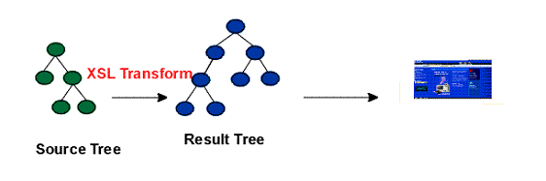
Browser-side usage of XSL
In browser-side usage of XSL, we simply use the XSLT part of XSL to transform XML into HTML
This HTML is then rendered by the browser

Slide 12
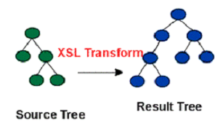
Trees in XSLT
In XSLT, the source and result document are viewed as trees
  the types of nodes include element nodes, attribute nodes and text nodes.
A stylesheet written in XSLT consists of a set of a set of template rules.
A template rule has two parts:
  a pattern which is matched against nodes in the source tree and
  a template which can be instantiated to form part of the result tree.

Slide 13
XSLT Stylesheets
An XSLT stylesheet is itself an XML document
The root element is of type xsl:stylesheet but xsl:transform may be used as a synonym for xsl:stylesheet
Thus, an XSLT stylesheet may look like this
    <?xml version="1.0"?>
    <xsl:stylesheet … >
    …
    </xsl:stylesheet>
Or like this:
    <?xml version="1.0"?>
    <xsl:transform … >
    …
    </xsl:transform>

Slide 14
XSLT Stylesheets
Two attributes are required for the root element:
  version – at present the correct value is “1.0”
  xmlns:xsl – at present, the correct values of this is
    "http://www.w3.org/1999/XSL/Transform”
Thus, an XSLT stylesheet may look like this
  <?xml version="1.0"?>
  <xsl:transform
  version=“1.0”
  xmlns:xsl= "http://www.w3.org/1999/XSL/Transform” >
  …
  </xsl:transform>

Slide 15
Elements within the root element
The root element (xsl:stylesheet or xsl:transform) may contain a great many different types of elements
However, the most commonly-used element is the xsl:template element
  Each xsl:template element is used to specify a template rule for transforming one kind of node in the tree for the source XML document

Slide 16
Fragment from an XSLT style-sheet
The following shows the root node and first-level child nodes of an XSLT stylesheet
<?xml version="1.0"?>
<xsl:transform version=“1.0”
xmlns:xsl=“http://www.w3.org/1999/XSL/Transform” >
  <xsl:template> … </xsl:template>
<xsl:template> … </xsl:template>
<xsl:template> … </xsl:template>
<xsl:template> … </xsl:template>
</xsl:transform>

Slide 17
xsl:template elements
An xsl:template element is used to specify a template rule
Each xsl:template element has a match attribute which is used to specify a type of node in the source tree
The content of an xsl:template element specifies the corresponding structure in the result tree

Slide 18
The match attribute in xsl:template elements
The match attribute in a template specifies the type of source node to which the template rule applies
The value of a match attribute is an expression from a language called XPath
We will consider XPath in more detail later
For now, it is enough to know that an XPath expression simply specifies a certain class of node in an XML file
An XPath expression may be as simple as a tag-name
For example, the following template can be used to transform any person element
    <xsl:template match=“person”>
    …
    </xsl:template>
However, certain meta-characters may also be used in XPath expressions

Slide 19
Meta-characters in XPath patterns
Meta-characters that may be used in match patterns include: / * | / //
Here are some examples of patterns:
  The pattern / matches the root node
  The pattern * matches any element
  The pattern male|female matches any male element and any female element
  The pattern poem/verse matches any verse element with a poem parent
  The pattern poem//line matches any line element with a poem element as an ancestor

Slide 20
The xsl:template element (contd.)
Thus, here are some example xsl:template elements:
  <xsl:template match=“/”> … </xsl:template>
  <xsl:template match=“*”> … </xsl:template>
  <xsl:template match=“person”> … </xsl:template>
  <xsl:template match=“male”> … </xsl:template>
  <xsl:template match=“male|female”> … </xsl:template>
  <xsl:template match=“person/male”> … </xsl:template>
  <xsl:template match=“person//age”> … </xsl:template>

Slide 21
Fragment from an XSLT style-sheet
The following shows the top-most levels of the XSLT stylesheet for processing our XML document about Bertie and Celia
  <?xml version="1.0"?>
  <xsl:transform version=“1.0”
  xmlns:xsl=“http://www.w3.org/1999/XSL/Transform”>
    <xsl:template match="/"> … </xsl:template>
  </xsl:transform>
The template matches the root element in the source document
  The content of the template will specify how to generate the corresponding result document

Slide 22
Content of xsl:template elements
The content of an xsl:template element specifies how to generate the result text that corresponds to the source node
The content may
  Simply specify some canned text
  Contain XSLT instruction elements
    these specify certain kinds of processing that should be performed on the source node in order to compute the appropriate result text
  Contain a mixture of canned text and XSLT instruction elements

Slide 23
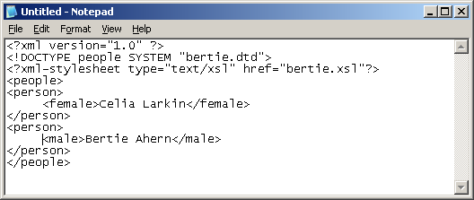
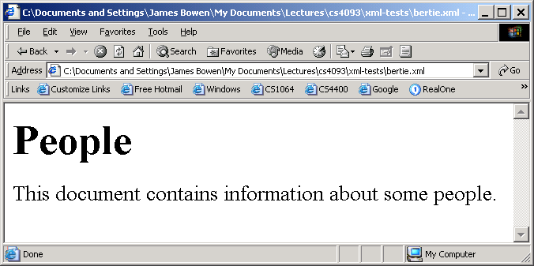
Canned text in an XSLT stylesheet
The stylesheet below transforms the entire source XML document (below-left) to some canned HTML text (below-right)
<?xml version="1.0"?>
<xsl:stylesheet xmlns:xsl="http://www.w3.org/1999/XSL/Transform" version="1.0">
<xsl:template match="/">
<html><body> <h1>People</h1>
<p>This document contains information about some people.</p></body></html>
</xsl:template>
</xsl:stylesheet>

Slide 24
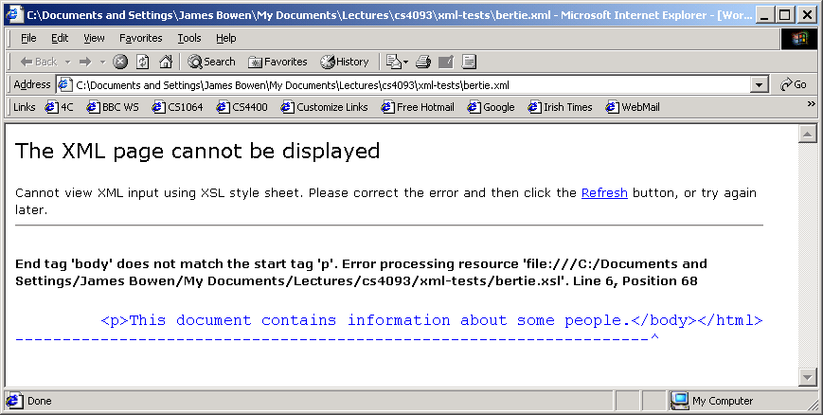
Canned HTML text must be well-formed XML
The stylesheet below is not well-formed XML because there is no closing tag for the <p> tag
  An error message is produced by the MS XML parser
<?xml version="1.0"?>
<xsl:stylesheet xmlns:xsl="http://www.w3.org/1999/XSL/Transform" version="1.0">
<xsl:template match="/">
<html><body> <h1>People</h1>
<p>This document contains information about some people.</body></html>
</xsl:template>
</xsl:stylesheet>

